Slide 1
Building a Product Security Team
A tale from the field
2025, June 19th
Francesco Giordano
francesco.giordano@pagopa.com
PagoPA S.p.A.

Slide 2

Who am I?
CYBERJOURNEY
Francesco Giordano
Senior Security Engineer at PagoPA S.p.A.

Slide 3

Who are we?
CYBERJOURNEY
Driving the digital transformation of the Italian Public Sector, delivering and maintaining software products at scale
Italian State-owned company (100% Ministry of Economy and Finance)
Serving 40+M users across different platforms (Payment Platform, Notification Platform, etc…)
Currently developing European Digital Identity Wallet for Italy

Slide 4
Our journey (surviving the scale-up)
CYBERJOURNEY
early 2020
mid 2025
< 50 employees
mainly 2 products
1 Cloud Service Provider (Azure)
probably you could count the number of important repos with your fingers
Product Security Engineers: 1
roughly 400 employees
more than 5 products (and growing)
3 CSP (Azure, AWS, GCP)
800+ Repositories
Product Security Engineers: 4 working as a Team

Slide 5





But what is a Product Security Team?
CYBERJOURNEY
Works alongside the Product Team
Performs security tests (no time-framed assessments)
Builds an “engineering” culture of security
Guide the Team in the Design phase
Scale as much as possible

Slide 6
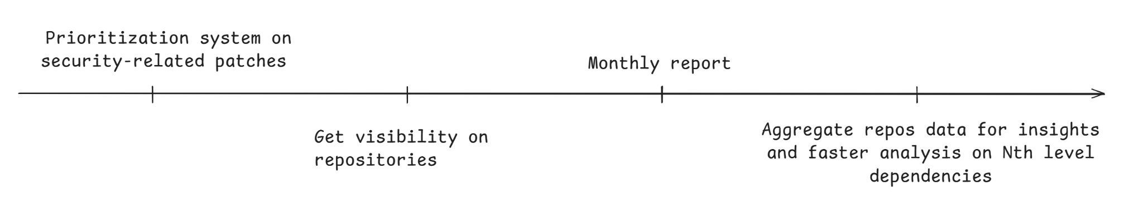
Ok, great. Now what?
CYBERJOURNEY
We had (probably conflicting) goals:
Have an up-to-date security knowledge on assigned products
Scale across the entire organization with a very small team (with automation and standards)

Slide 7
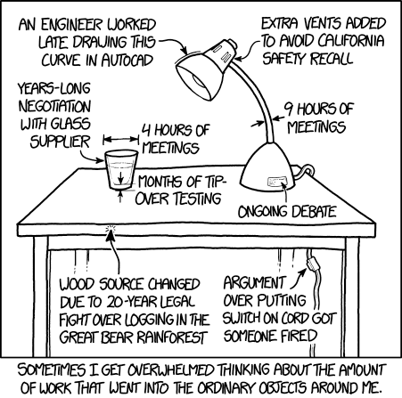
Have an up-to-date security knowledge on assigned products
CYBERJOURNEY
Threat modeling is important to identify critical components and define common risks
It should be performed alongside the product team
Assign security engineers to products

Slide 8
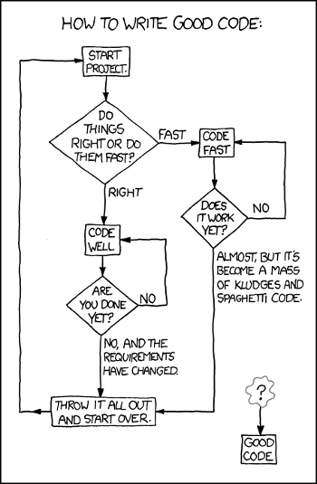
Scaling across the organization
CYBERJOURNEY
Identify areas in which automation could be impactful
Building platforms (write once, scale infinitely)

Slide 9
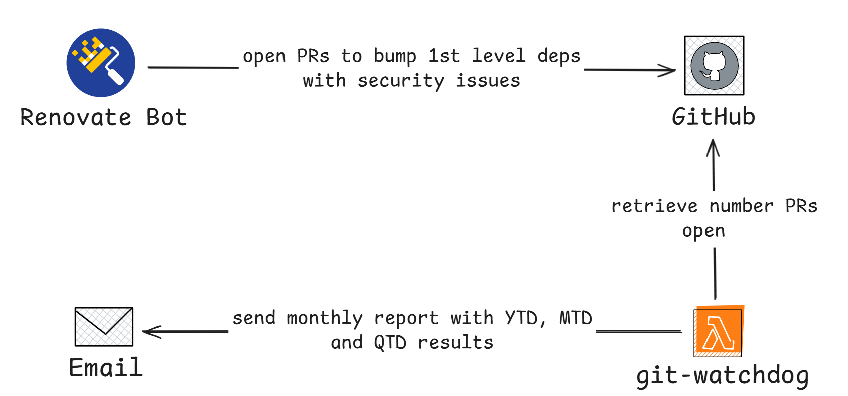
Git Watchdog
CYBERJOURNEY
Monitor the Organization for open PRs regarding security updates and repo security best practices
Send Monthly report (Gamification FTW)

Slide 10
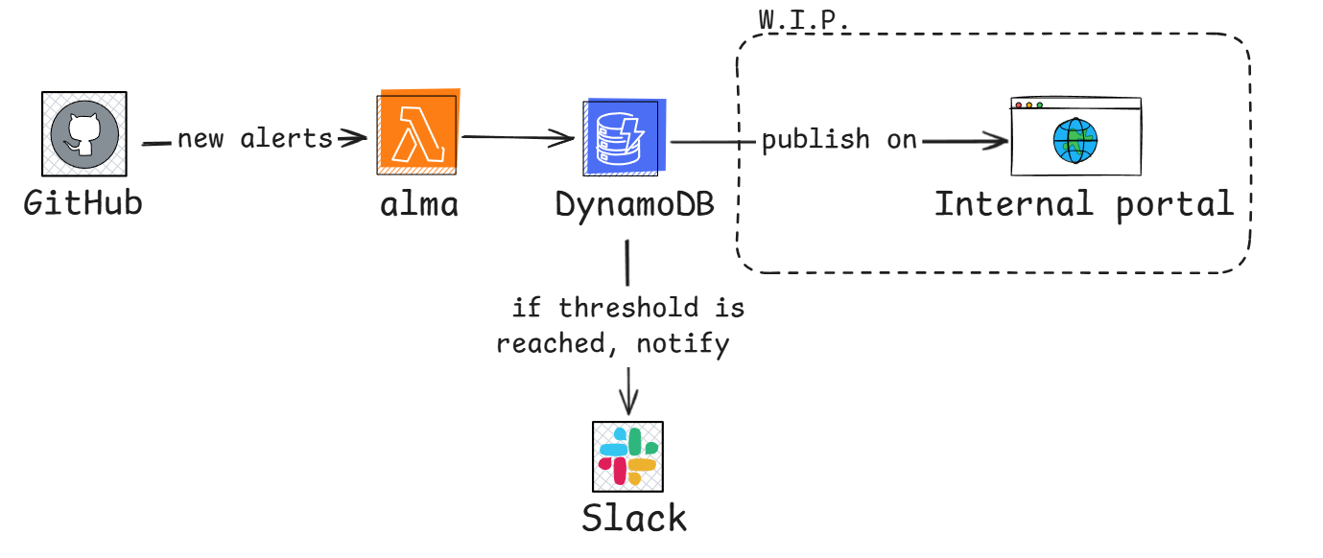
Managing GitHub Security Alerts with ALMA
CYBERJOURNEY
Leverage GitHub security Alerts to collect info on repo status
Get in-real-time alerts
Custom metrics to trigger escalation

Slide 11
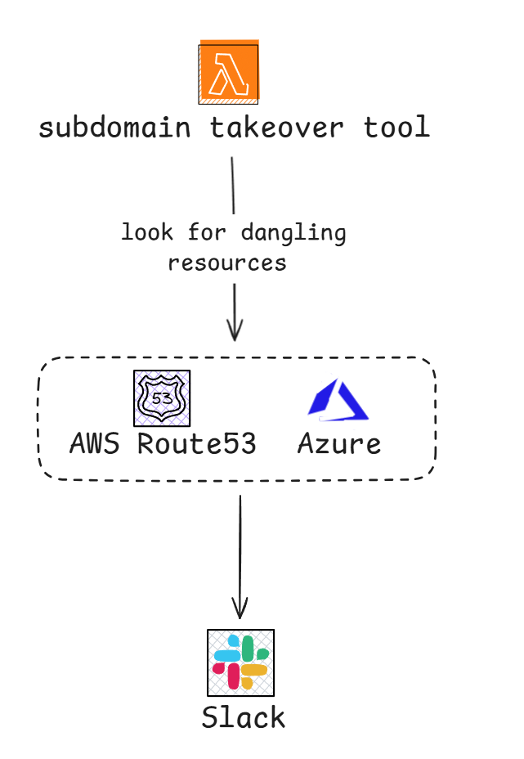
Subdomain Takeover Monitoring
CYBERJOURNEY
Identifies resources without a CNAME associated
Notify the product teams (shifting security ownership towards the product team)
More info on subdomain takeover: https://github.com/EdOverflow/can-i-take-over-xyz

Slide 12
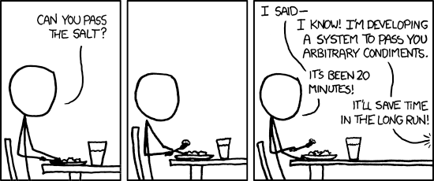
To be
CYBERJOURNEY
Identify improvements area across the organization
Keep building (we have some ideas regarding CodeQL…)
Hopefully open source our platform (sharing is caring)

Slide 13
THANKS FOR YOUR ATTENTION

